Slide 1
Cool Microcontroller Projects 2008 Rocket Altimeter
Dave VE3OOI
Feb 2021

Slide 2
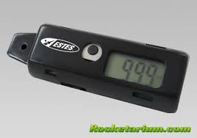
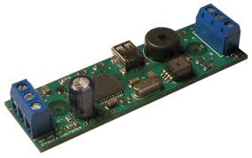
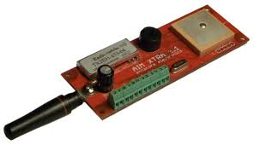
BACKGROUND
Needed a low-cost solution to
Measure altitude of rocket
Deploy a parachute
Had to be light weight
Had to be small
Simple to build – use pressure sensor

Slide 3
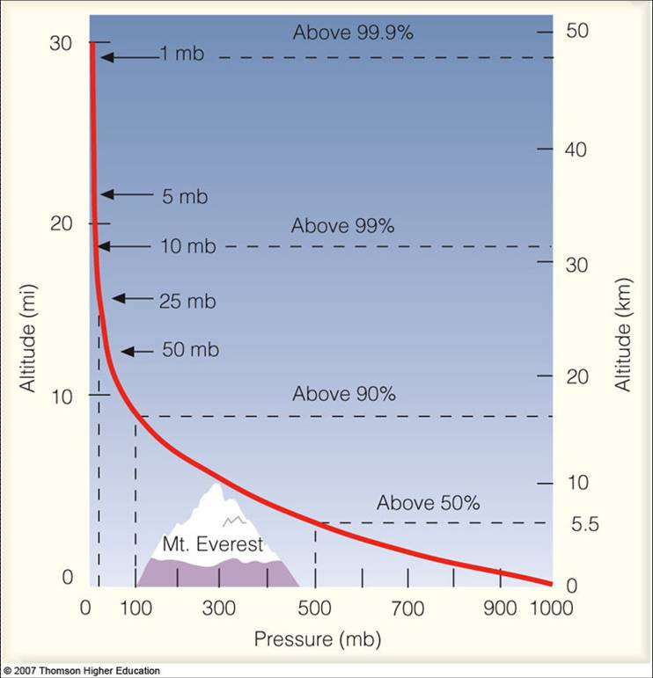
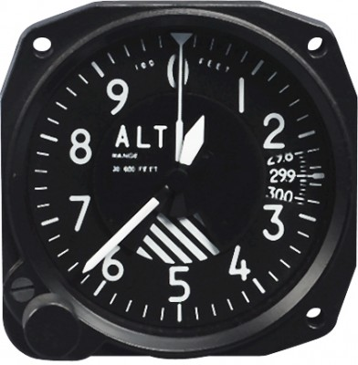
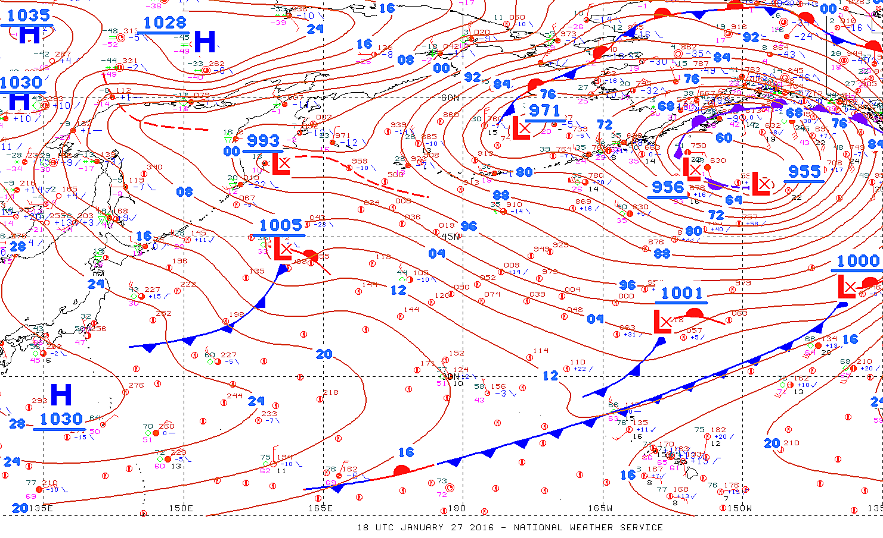

THEORY
Set to 30.28 based on ATIS
Almost linear relationship between pressure and altitude
Pressure not absolute changed dynamically
Altitude (AGL) is relative to pressure at ground
Airplane altimeter has a pressure setting

Slide 4
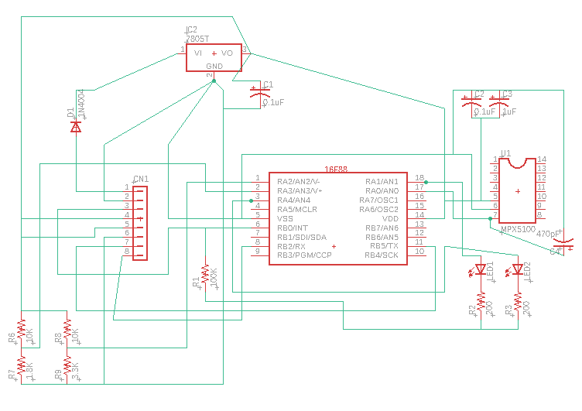
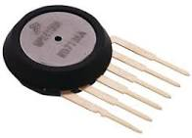
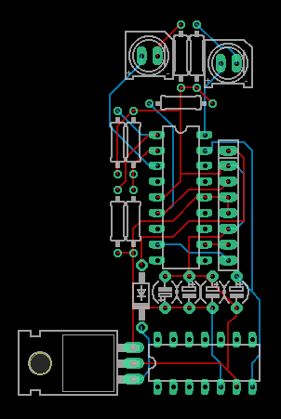
THE CIRCUIT
No copper pour for gnd plane
Little power decoupling. Just wait till you see the data

Slide 5
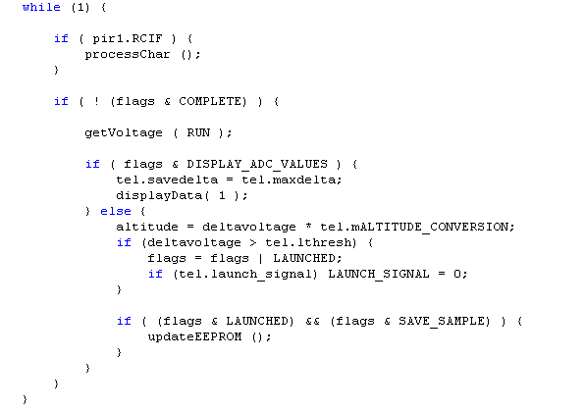
SOFTWARE
Calculates and average voltage from transducer and subtracts from a baseline generated when uC reset
Math done prior to identify altitude per ADC count
(e.g., 1 count = 30 feet)
Detect Launch. Voltage is greater than voltage above noise floor.
(e.g. prelaunch reading is currently 5 to 10, then set threshold to say 20)
Interrupt started on launch that indicated when to save a reading

Slide 6
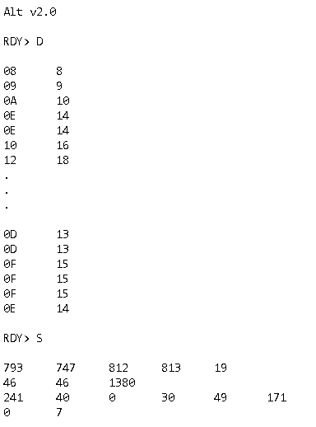
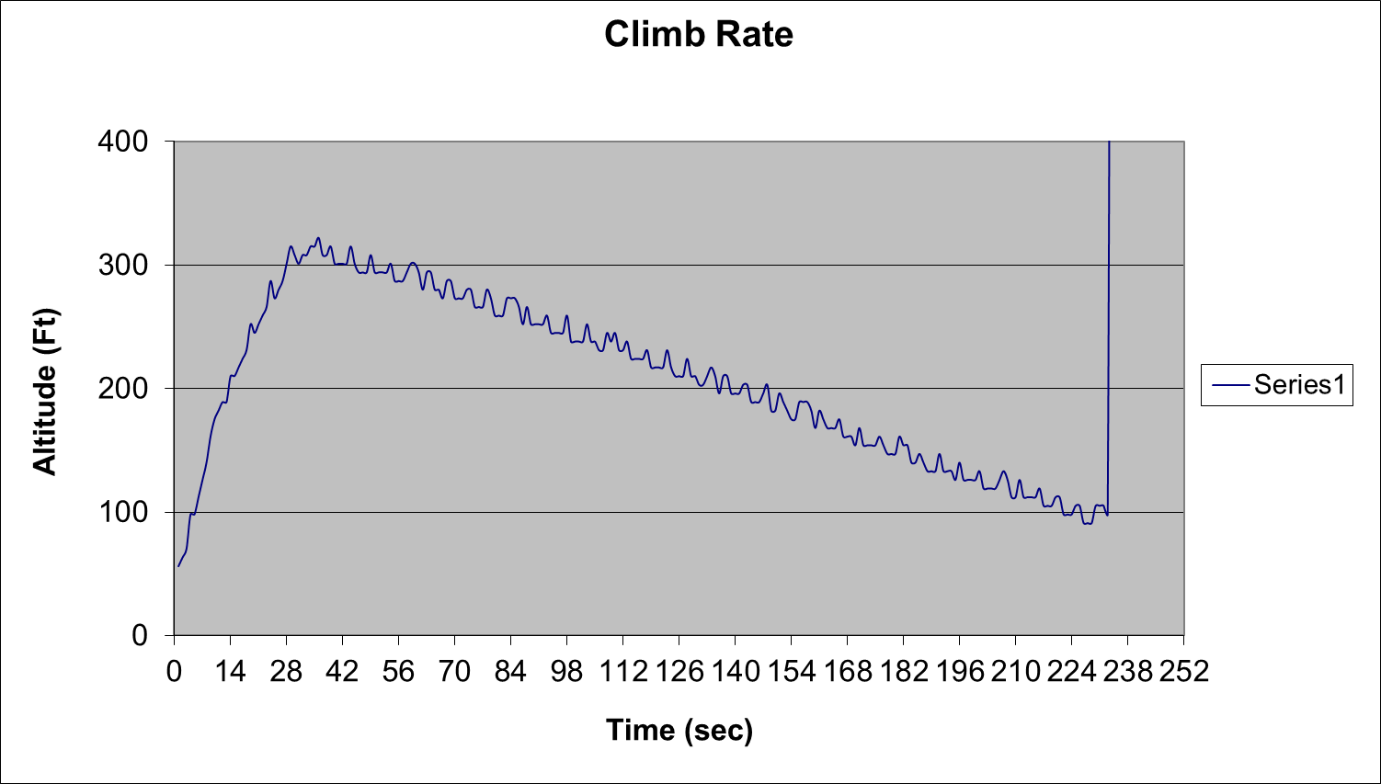
SAMPLE DATA

Slide 7
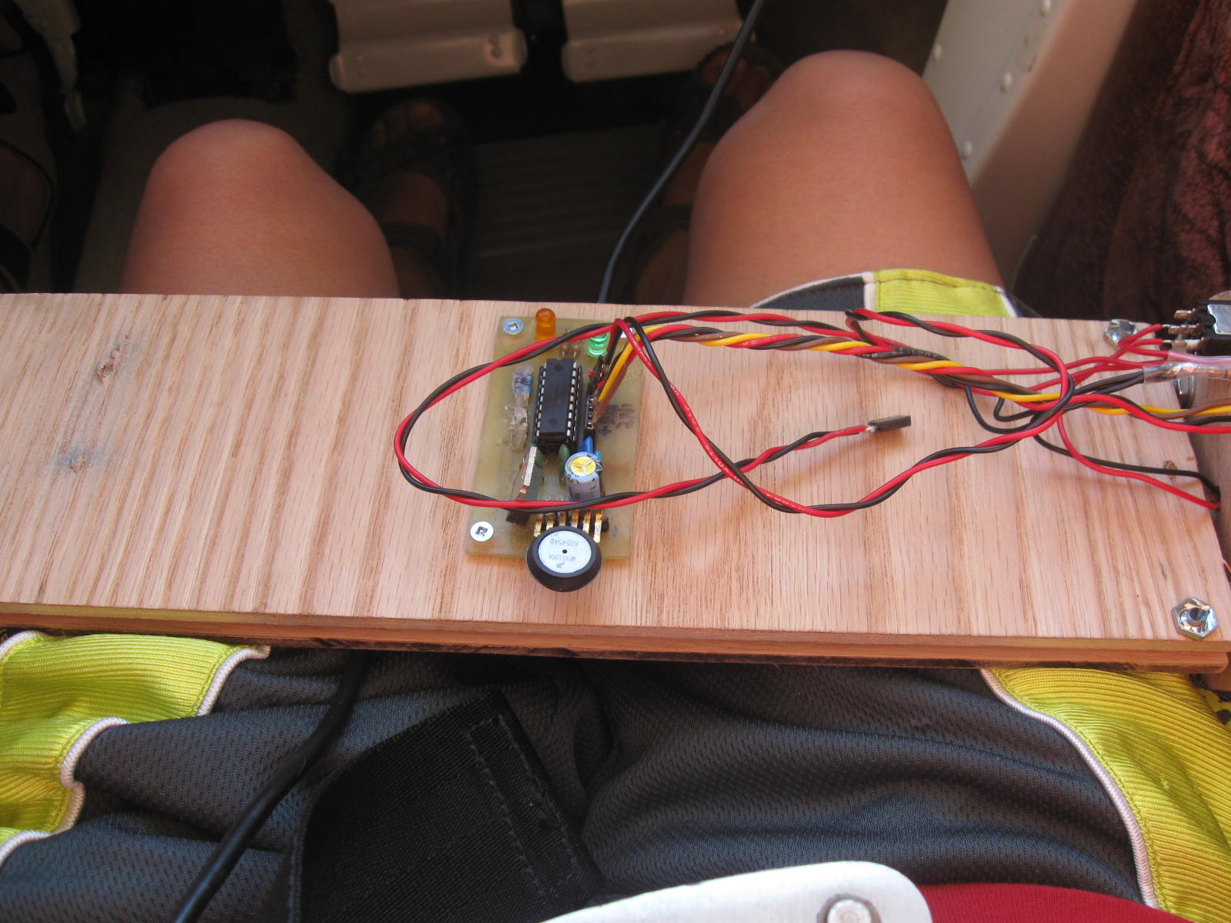
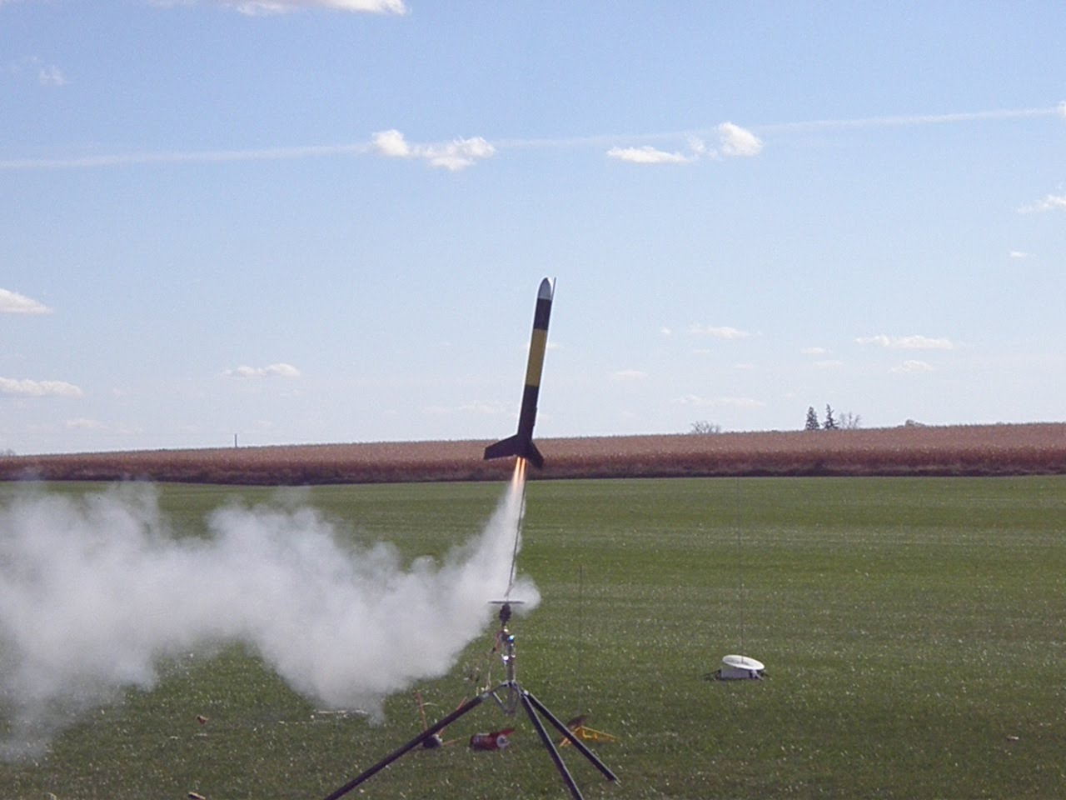
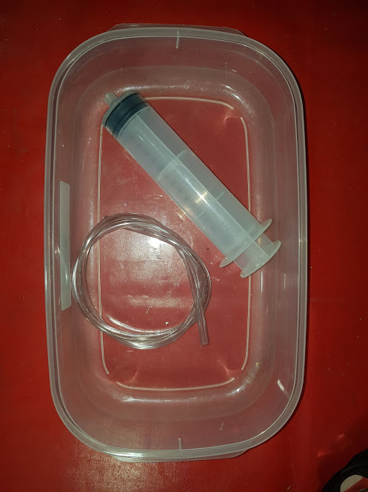
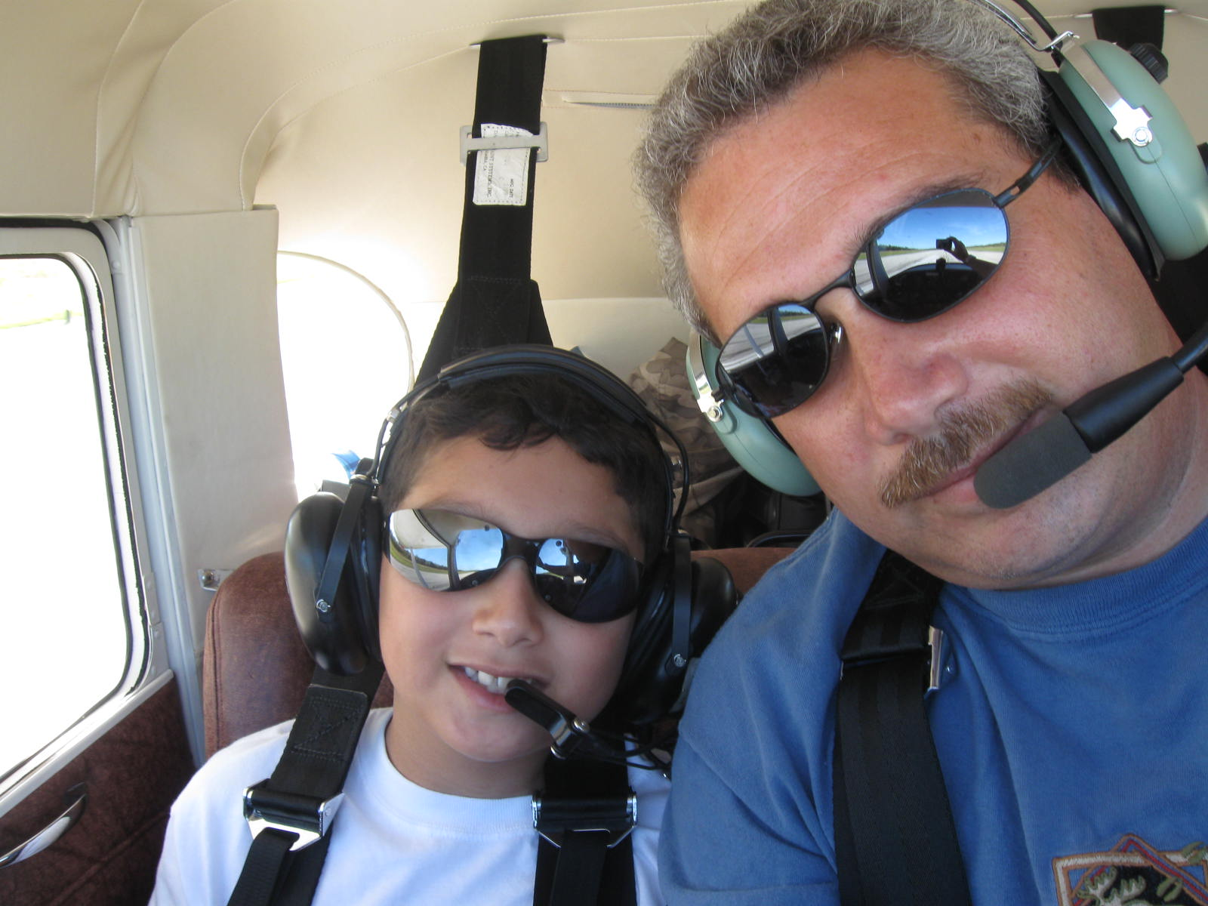
BETTER TESTING

Slide 8
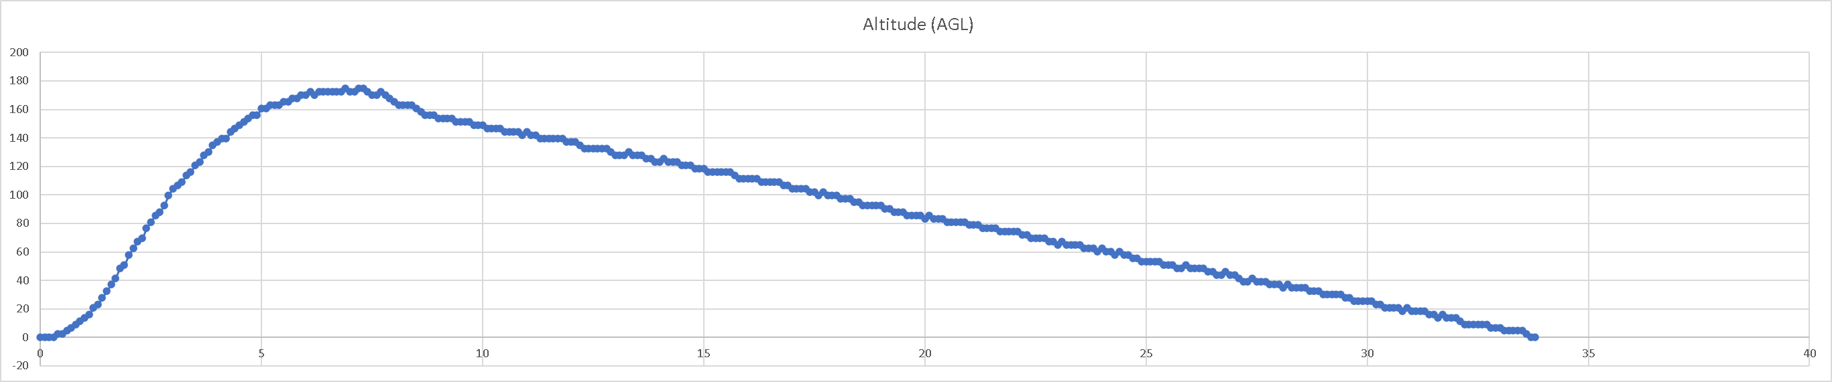
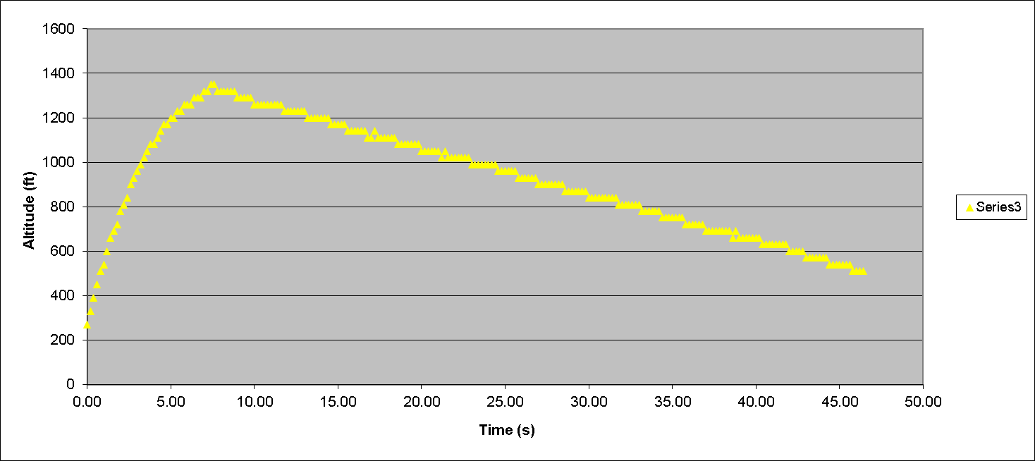
EVOLUTION

Slide 9
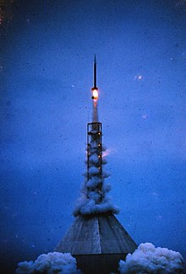
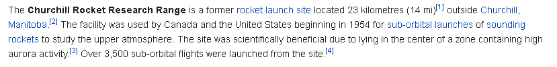
FIN

